Slide 1
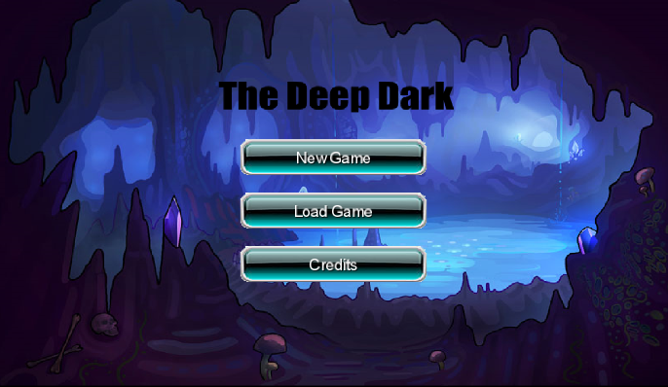
User Manual - Main Menu
This will call to GameScreen. When this is clicked the game starts with the character in the starting position with full mana and health. The enemies will begin spawning
This will load the game at the last state the game was in .
This will load the credits screen
Max Tauro, Matt Brock

Slide 2
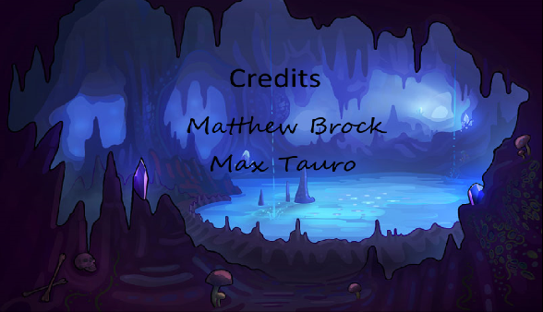
User Manual - Credits
This screen only holds our name and does nothing else. Hit back button on the device to return to Main menu.
Max Tauro, Matt Brock

Slide 3
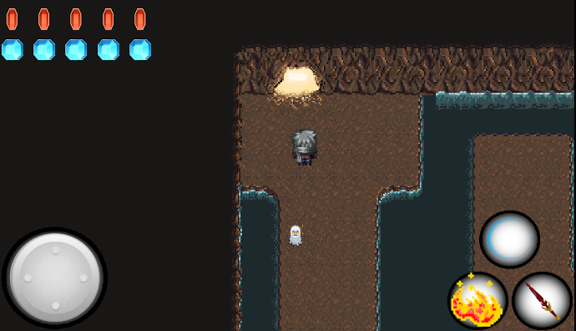
User Manual - Game
This is a door when the character moves on top of it, the map/level will change
Health. The number of gems indicates remaining health
This is the main character that the user will control
Mana. The number of gems indicates remaining Mana
This is the shield button. If the shield is not on cooldown it will form a shield when pressed
The control stick. This will allow the user to move the character
This is the sword button. It allows the user to use a melee attack when pressed
This is the enemy, they will follow the main character if he is close enough.
This is the Fireball button, if the user has mana , it will shoot a fireball when pressed
Max Tauro, Matt Brock

